Slide 1
Blazing Trail Junctions
Policy Council
November 5, 2019
Notes:
Welcome
Introductions
Name/ favorite trail

Slide 2
Trail Junctions
Hikers often miss trail junctions and become lost
Some simple measures can be very helpful
Wider trimming of vegetation, better blazing, signage, cairns
Some parks use special blazing at junctions
Your RTC meeting is a good place to talk about the options and how to find the best solution

Slide 3
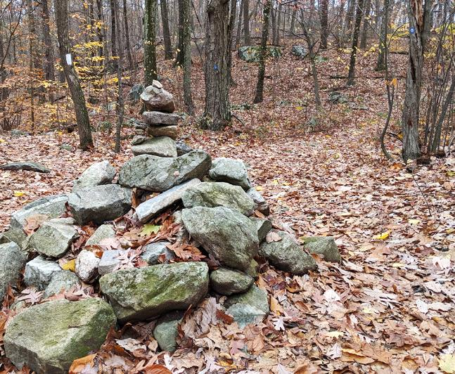
Making Trail Junctions More Visible
Clear confirmation blazes for both trails
Blue Trail
Sign, post, or cairn
Provide greatest visibility, but can be costly and subject to vandalism
May be appropriate for major or difficult to find junctions
Red Trail
More foliage clearing near junction

Slide 4
Special Blazes for Trail Junctions
Some parks use special blazes to mark junctions
The following pages show some examples
There is no universal convention at present
These can be useful, but many beginning hikers don’t even understand our current blazes
Trail chair or supervisor must work with the land manager about whether to use special blazes and which to use and must instruct the maintainers

Slide 5
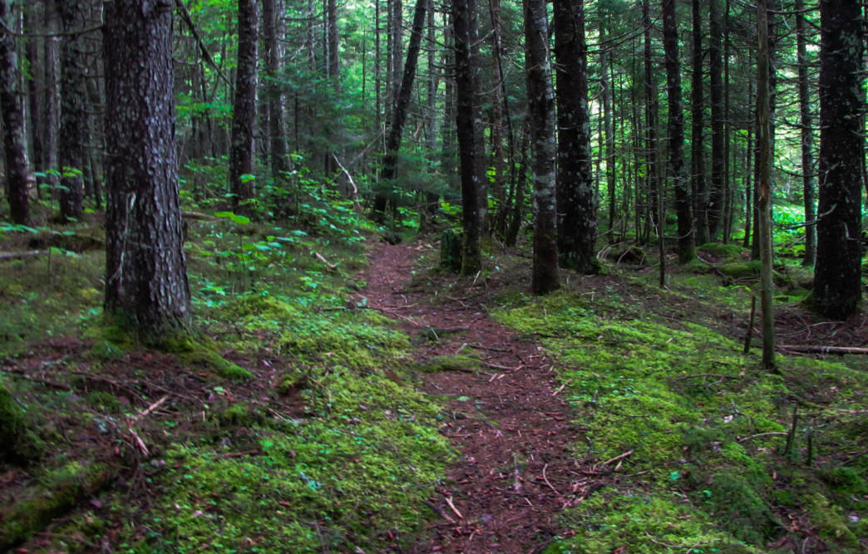
Trail Crossing without Special Blazing
No indication of approaching
trail crossing
Blue Trail
Red Trail

Slide 6
Trail Crossing with Special Blazing
One type of special blaze to indicate the
upcoming blue trail crossing
Blue Trail
Red Trail

Slide 7
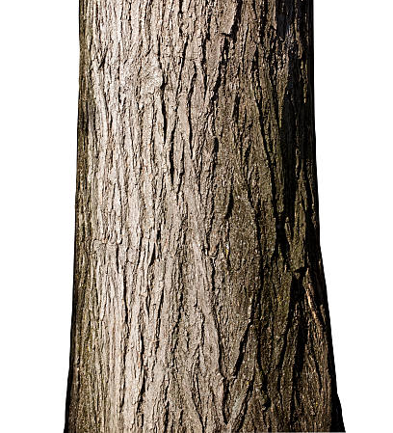
Option 1 (double arrow)

Slide 8
Option 2 (two arrows)

Slide 9
Option 3 (two horizontal)

Slide 10
Option 4 (two vertical)

Slide 11
Option 5 (three vertical)

